Slide 1
Project Details
Title: “Music Playlist Implementation”
Subtitle: “Using HTML, CSS, and JavaScript”

Slide 2
Music Playlist Design
Music List to select the song.
Volume Container to change the sound.
The Function is Add Music And Delete Music .

Slide 3
Music Playlist in Action
Listening to music can be effective way to cope with stress.
User interaction through navigation arrows and dots.
User can also pause the music.

Slide 4
Project Overview
Objective:
Explain that the goal was to create an Music Playlist using HTML,
CSS, and JavaScript.
Features:
Highlight the key features like automatic change when complete song,
navigation arrows, pause button , indicator dots .

Slide 5
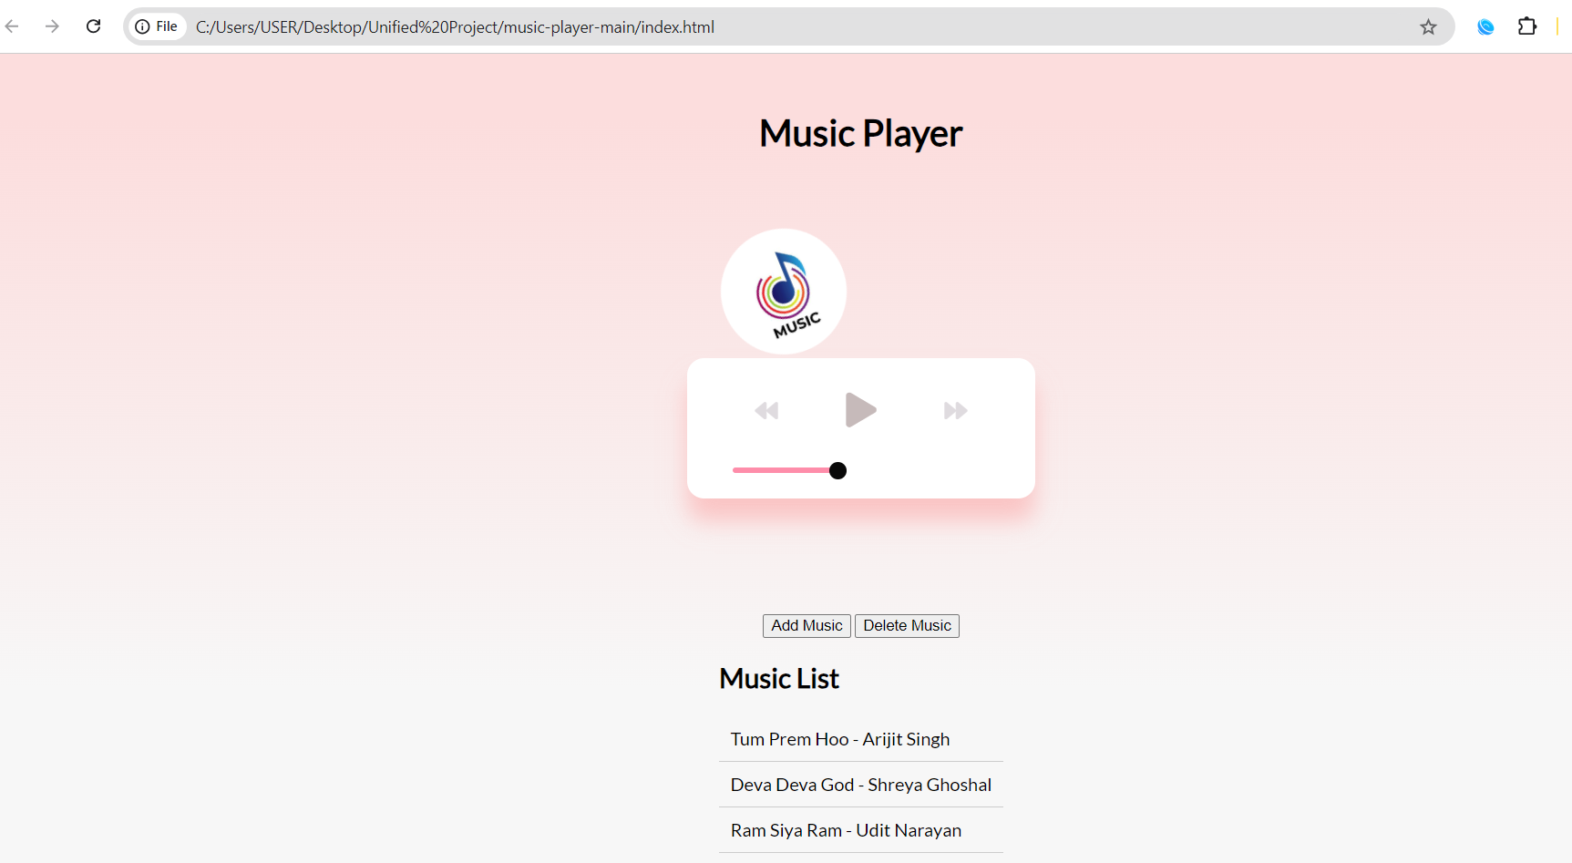
Screenshot-1

Slide 6
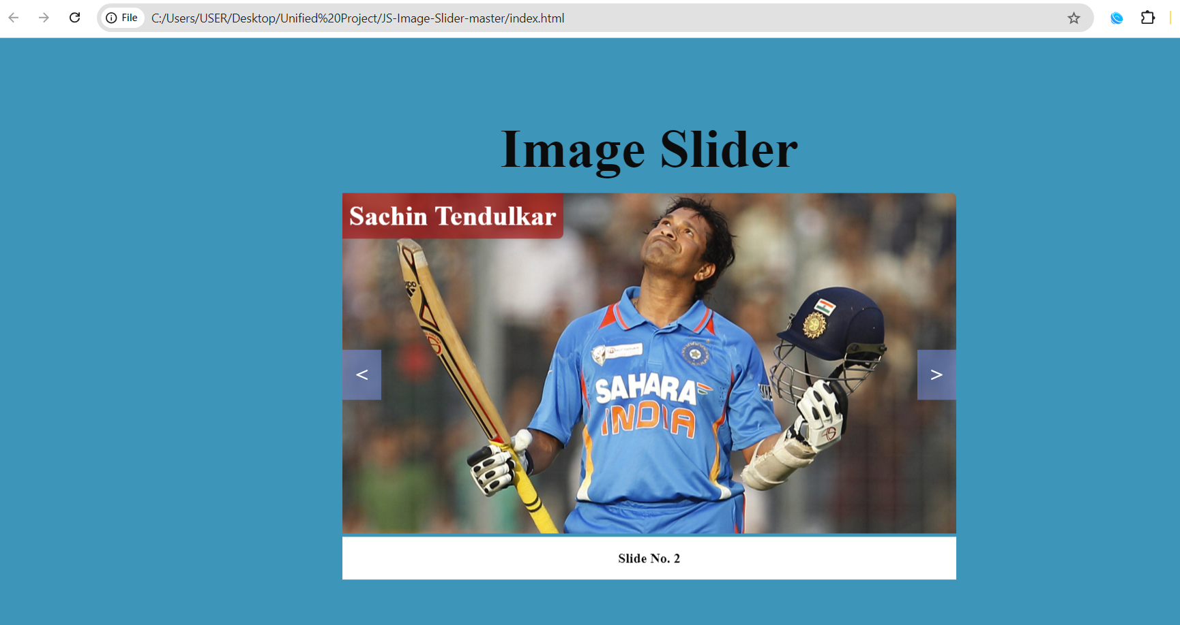
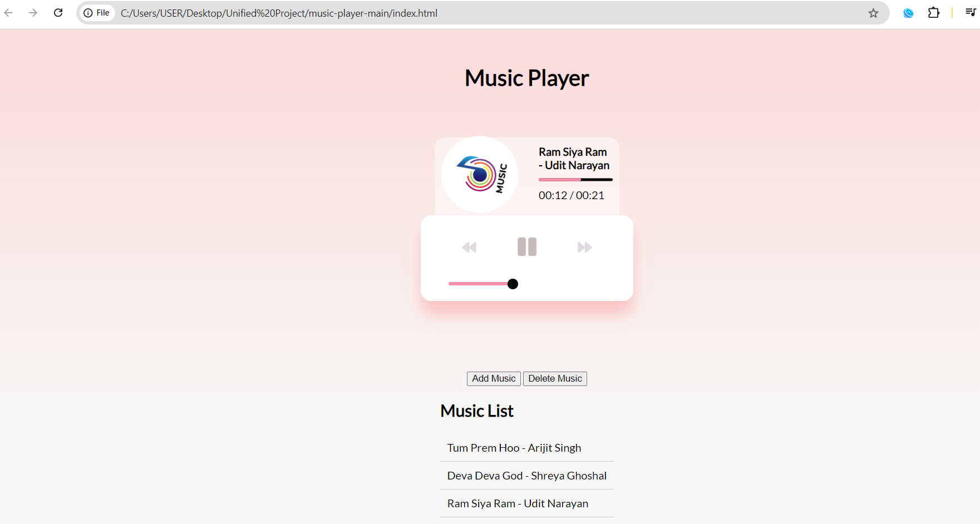
Screenshot-2

Slide 7
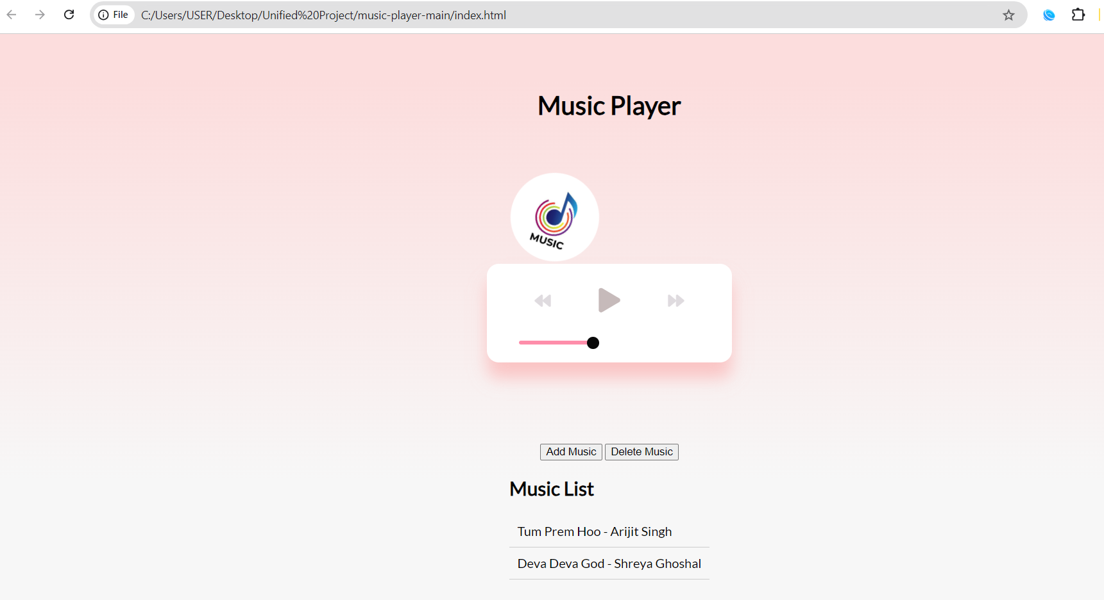
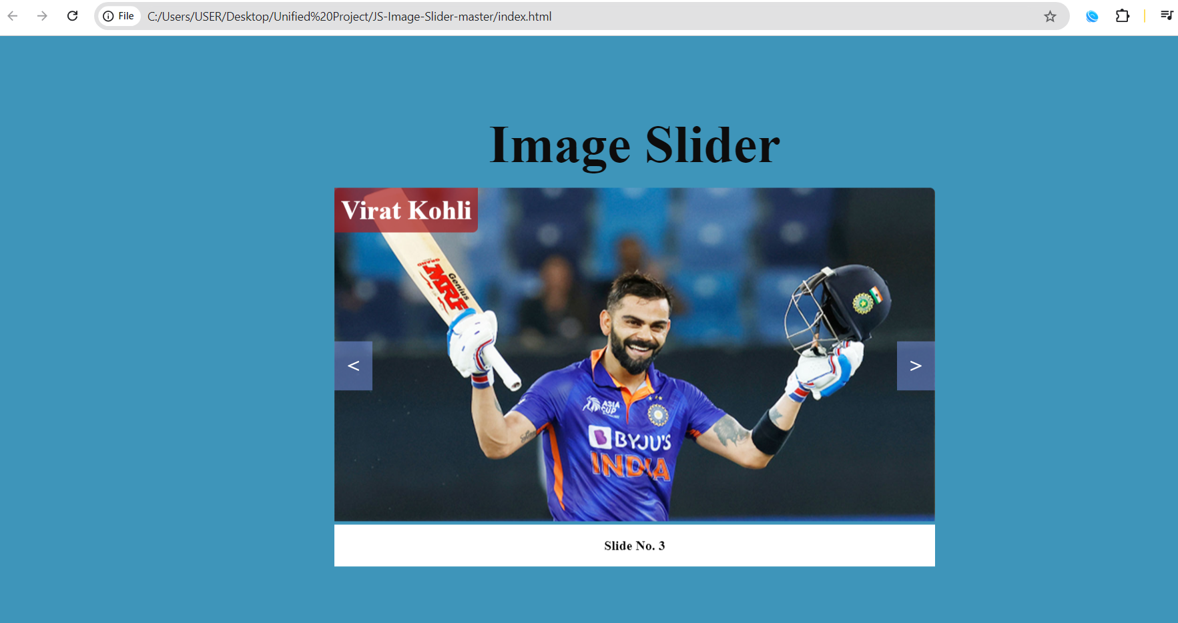
Screenshot-3

Slide 8
Thank You

